Slide 1



McNeary Consulting Services
Lynne Skelton | Barbara Valentine

Slide 2
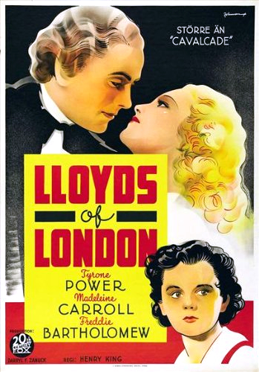

Lloyds of London
Plot:
As a young lad, Jonathan Blake and his friend Horatio Nelson come across an insurance fraud. Jonathan travels to London to visit Lloyd's coffee house, where various syndicates insure shipping ventures. Jonathan's information saves the syndicates a good deal of money and as his reward he asks only that he be allowed to learn the trade. As an adult he becomes a successful insurance underwriter and his syndicate becomes quite profitable. A crisis occurs when they learn that 63 ships were sunk off the Azores by Napoleon's navy. Insurance rates rise dramatically and ship owners refuse to go to sea. Jonathan proposes that they use the old rates in order to ensure Nelson can use his fighting ships in battle and not as convoy ships. Nelson's victory at Trafalgar means the British navy will use the seven seas.
Blake is in love with an aristocratic woman whose husband seriously injures him. Blake's friendship with Lord Nelson provides the basis for Blake's part in the growth of Lloyd's insurance business following the Battle of Trafalgar. Only very slightly based on history.

Slide 3
Lloyds of London – Corporate History
First mention February 1688 – Edward Lloyd’s Coffee House in Tower Street
1730’s – Lloyd’s begins to dominate shipping insurance
1757 – Underwriting first appeared, with actual records of a Quaker businessman’s journal stating he went to Lloyd’s coffee House and subscribed the book at two guineas a year.
1811 – The creation of Lloyd’s Agency
  By 1811, the complexity of the information used by the insurance industry had evolved significantly, but it was the creation of a network of Agents by Lloyd’s which profoundly accelerated both the reach and impact of that information.
  For the first time, a global network of individuals could act as the eyes and ears of the market, finding out the truth, detecting problems and suggesting solutions. The flow of information they sent back to Lloyd’s was a vital component of the consolidation and growth of both Lloyd’s reputation and the added values and expertise it could offer customers.
1905- Non-Marine lines of coverage appeared, as well as risk-based pricing.
1928-Lloyd’s moved into their first building at 12 Ludenhall Street
1965-Lloyd’s first admitted foreign members
1998-The government announced that Lloyd’s would no long be self-regulated and would be subject to oversight by the new Financial Services Authority
2008-Lloyd’s Act amended
  Historic amendments to the Lloyd’s Act modernised elements of the way the market would be governed and removed unnecessary restrictions on how Lloyd’s organised its affairs. These included doing away with the requirement that risks had to be placed via a Lloyd’s broker and ending rules preventing brokers from owning managing agents.

Slide 4

P/C Insurance Industry Outlook
Focus on Claims Trends
March 23, 2018
Robert P. Hartwig, Ph.D., CPCU
Clinical Associate Professor of Finance, Risk Management & Insurance
Darla Moore School of Business ♦ University of South Carolina
Robert.Hartwig@moore.sc.edu ♦ 803.777.6782

Slide 5
P/C Insurance Industry Financial Overview
CATS Claims, Non-CAT Underwriting Losses in Personal and Commercial Auto Impacted Insurer Balance Sheets
Industry Remains Strong, But Major Differences Between Personal and Commercial Lines Growth Prospects
5

Slide 6
P/C Industry Net Income After Taxes
1991–2017E
$ Millions
2005 ROE*= 9.6%
2006 ROE = 12.7%
2007 ROE = 10.9%
2008 ROE = 0.1%
2009 ROE = 5.0%
2010 ROE = 6.6%
2011 ROAS¹ = 3.5%
2012 ROAS¹ = 5.9%
2013 ROAS¹ = 10.2%
2014 ROAS¹ = 8.4%
2015 ROAS = 8.4%
2016 ROAS = 6.2%
2017E ROAS =4.2%*
Net income fell sharply in 2017 as high CAT losses took their toll
ROE figures are GAAP; ¹Return on avg. surplus. Excluding Mortgage & Financial Guaranty insurers yields a 8.2% ROAS in 2014, 9.8% ROAS in 2013, 6.2% ROAS in 2012, 4.7% ROAS for 2011, 7.6% for 2010 and 7.4% for 2009; 2016E is annualized figure based actual figure through Q3 of $31.8B.
Sources: A.M. Best, ISO; USC RUM Center estimate (2017 based on actual NIAT of $22.352 though Q3 and ROAS of 4.2%).

Slide 7
Profitability Peaks & Troughs in the P/C Insurance Industry, 1975 – 2017:Q3
ROEs in 2017 plunged to their lowest levels since 2001 and 9/11. This creates extreme pricing pressure.
ROE
1977:19.0%
1987:17.3%
10 Years
1997:11.6%
2006:12.7%
10 Years
2015: 8.4%
9 Years
2013 9.8%
2016 6.2%
1975: 2.4%
1984: 1.8%
1992: 4.5%
2001: -1.2%
2017E 4.2%
*Est. for 2017 based on actual ROAS of 4.45 through Q2; Profitability = P/C insurer ROEs. 2011-16 figures are estimates based on ROAS data. Note: Data for 2008-2014 exclude mortgage and financial guaranty insurers.
Source: NAIC, ISO, A.M. Best, Conning, USC RUM Center estimates.

Slide 8
ROE: Property/Casualty Insurance by Major Event, 1987–2017E
(Percent)
P/C Profitability Is Influenced Both by Cyclicality and Volatility
Katrina, Rita, Wilma
Harvey, Irma, Maria, CA Wildfires
Low CATs
Sept. 11
Hugo
Lowest CAT Losses in
15 Years
4 Hurricanes
Sandy
Andrew, Iniki
Northridge
Financial Crisis*
Record Tornado Losses
*2017 Estimate based on actual ROAS through Q3 of 4.2% with USC Center for Risk and Uncertainty Management estimate for the full year.
Excludes Mortgage & Financial Guarantee in 2008 – 2014.
Sources: ISO, Fortune; USC RUM Center.

Slide 9
P/C Insurance Industry
Combined Ratio, 2001–2017:Q3*
Heavy Use of Reinsurance Lowered Net Losses
Relatively Low CAT Losses, Reserve Releases
Higher CAT Losses, Shrinking Reserve Releases, Toll of Soft Market
As Recently as 2001, Insurers Paid Out Nearly $1.16 for Every $1 in Earned Premiums
Sharply higher CATs are driving large underwriting losses and pricing pressure
Relatively Low CAT Losses, Reserve Releases
Avg. CAT Losses, More Reserve Releases
Best Combined Ratio Since 1949 (87.6)
Cyclical Deterioration
Sandy Impacts
Lower CAT Losses
* Excludes Mortgage & Financial Guaranty insurers 2008--2014. Including M&FG, 2008=105.1, 2009=100.7, 2010=102.4, 2011=108.1; 2012:=103.2; 2013: = 96.1; 2014: = 97.0.; 2017 (est.) based on actual 104.1 through Q3 (Q3 combined ratio alone was 110.7).
Sources: A.M. Best, ISO (2014-2015); Figure for 2010-2013 is from A.M. Best P&C Review and Preview, Feb. 16, 2016.

Slide 10
Commercial Lines Combined Ratio, 1990-2017F*
Commercial lines underwriting performance deteriorated materially in 2017 as record CATs. diminishing prior year reserves, rising loss cost trends and pricing pressure in some lines are pushing combined ratios higher
*2007-2012, 2017 figures exclude mortgage and financial guaranty segments. 17E = actual 9 mo. YTD figure of 106.2.
Source: A.M. Best (1990-2016); ISO (2017E).

Slide 11
Policyholder Surplus,
2006:Q4–2017:Q3
($ Billions)
Drop due to near-record 2011 CAT losses
Financial Crisis
Surplus (Capacity) as of 9/30/17 reached a new record of $719.4B despite record CAT losses
2010:Q1 data includes $22.5B of paid-in capital from a holding company parent for one insurer’s investment in a non-insurance business .
Capacity/Capital “shocks” typically do not on their own drive a sustained firming of the pricing environment
Sources: ISO, A.M .Best; 2018 estimate from the Center for Risk and Uncertainty Management, University of South Carolina.
11
12/01/09 - 9pm
eSlide – P6466 – The Financial Crisis and the Future of the P/C
Notes:
11

Slide 12
Catastrophe Loss Update: Major Driver of Rate Pressure
2017 Was One of the Costliest Years Ever for US Insurers
Hurricanes Harvey, Irma and Maria, California Wildfires Exact a Huge Toll
12

Slide 13
Global Insured Catastrophe Losses,
2000 – 2017E
2017 was one of the top 3 costliest years ever for insurers on a global scale
($ Billions, $ 2017)
*Estimate
Sources: Swiss Re, RMS, Barclays Research.
13
12/01/09 - 9pm
eSlide – P6466 – The Financial Crisis and the Future of the P/C
Notes:
13

Slide 14
U.S. Insured Catastrophe Losses,
1989 – 2017 YTD*
2017 is likely to become the second costliest year ever for insured CAT losses in the US
($ Billions, $ 2015)
*As of Dec. 31, 2017. Stated in 2017 dollars. Excludes NFIP losses.
Note: 2001 figure includes $20.3B for 9/11 losses reported through 12/31/01 ($25.9B 2011 dollars). Includes only business and personal property claims, business interruption and auto claims. Non-prop/BI losses = $12.2B ($15.6B in 2011 dollars.)
Sources: Property Claims Service/ISO; Insurance Information Institute.
14
12/01/09 - 9pm
eSlide – P6466 – The Financial Crisis and the Future of the P/C
Notes:
14

Slide 15
Top 10 US Catastrophe Losses of 2017, by Insured Loss
(Insured Losses, 2017 Dollars, $ Billions)*
YTD insured CAT losses in the US totaled $72 billion by late 2017, the second costliest year on record, led by Hurricanes Maria, Irma and Harvey
Not all insured losses in 2017 were due to hurricanes. More than $15B in other losses occurred from coast-to-coast.
*As of Nov. 14, 2017.
Sources: PCS; Insurance Insider: http://www.insuranceinsider.com/-1270818/9.

Slide 16
Inflation Adjusted U.S. Catastrophe Losses by Cause of Loss, 1997–2016¹
Other Wind/Hail/Flood (3), $29.7
Fires (4), $8.4
Winter storm losses were much above average in 2014/15 pushing this share up
Other (5), $0.8
Insured cat losses from 1997-2016 totaled $421.2B, an average of $21.1B per year or $1.76B per month
Terrorism, $25.0
Winter Storms, $28.2
Hurricanes & Tropical Storms, $161.1
Tornado share of CAT losses is rising
Wind losses, by far, cause the most catastrophe losses, even if hurricanes/TS are excluded.
Events Involving Tornadoes (2), $168.1
Catastrophes are defined as events causing direct insured losses to property of $25 million or more in 2016 dollars.
Excludes snow.
Does not include NFIP flood losses
Includes wildland fires
Includes civil disorders, water damage, utility disruptions and non-property losses such as those covered by workers compensation.
Source: ISO’s Property Claim Services Unit.

Slide 17
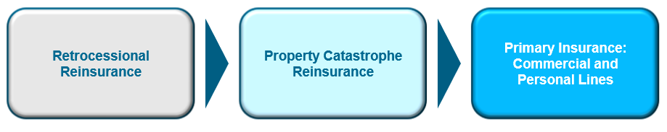
Origins of Pricing Pressure Arising from (Near) Record CAT Activity
+10% to +20%*
Non-Loss Affected: +5%
Loss-Affected: +10% to +15%**
0% to +5%
Retrocessional Reinsurance markets (reinsurance for reinsurance companies) are pushing pressure through the reinsurance markets and into both commercial and personal lines
*Some programs above and below this range.
**Higher end of range applies to loss-affected accounts.
Sources: Adapted from Barclay’s Capital research.
17
Notes:
17

Slide 18
Catastrophe Claims and Hard Markets
Year | CAT claims over $35 billion ($2016, billions) | Growth of (NWP-GDP) in following year | Hard Market?
1992 | $39.6 | 0.9% | No
2001 | $36.4 | 12.0% | Yes
2004 | $36.4 | -6.2% | No
2005 | $77.1 | -3.1% | No
2011 | $35.2 | 0.2% | No
2012 | $36.8 | 1.3% | No
2017 | $75+ | ? | ?
Contrary to conventional wisdom, heavy CAT activity does not generally precipitate a hard market
Source: Insurance Information Institute.

Slide 19
P/C Insurance Industry ROE and Hard Markets
Year | P/C Industry ROE less than 4% | Growth of (NWP-GDP) in following year | Hard Market?
1975 | 2.4% | 10.7% | Yes
1984 | 1.8% | 14.6% | Yes
2001 | -1.2% | 12.0% | Yes
2002 | 2.1% | 5.1% | Yes
2017 | ~4% | ? | ?
Depressed ROEs are a historically reliable predictor of hard markets
Source: Insurance Information Institute.

Slide 20
Hard Markets: Conclusion &
Implications for 2018
Low ROE is the best predictor of a hard market (likely around 4% in 2017), but does this mean a hard market is a sure thing?
  No…but some “correction” is possible
Surplus in 2017 was nearly flat to slightly up
  Capacity remains generally abundant and seems likely to grow–not drop–due to asset value growth, implying that a true hard market is unlikely to develop as a result of depleted capacity
CAT Losses: 2017 was one of the worst years on record for cat losses–implying a hard market–but this predictor does not appear to be an accurate one, at least in isolation
  Greatest impacts are driven through property cat reinsurance and retro markets on loss impacted areas and accounts

Slide 21
INVESTMENTS:
THE NEW REALITY
Investment Performance is a Key Driver of Insurer Profitability
The “Trump Bump” Has Lifted Stock Markets and Interest Rates
Will the Gains Help Insurers?
21

Slide 22
Property/Casualty Insurance Industry Investment Income: 2000–2017E*
Investment earnings in 2017E were still ~14% below their 2007 pre-crisis peak
($ Billions)
Due to persistently low interest rates, investment income fell in 2012, 2013 and 2014 but showed a small (1.7%) increase in 2015—though 2016 experienced another decline. Up ~2% in 2017.
¹ Investment gains consist primarily of interest and stock dividends. Sources: ISO; Insurance Information Institute.
*2017 estimate based on annualized $35.4B actual figure through Q3 2017.

Slide 23
2016 Commercial Market Growth by Coverage
Commercial auto rates increased as carriers reacted to ongoing challenges
Property, Workers’ Compensation under most severe rate pressures
Umbrella, excess, specialty lines liability growth may have reflected trading price for quantity (i.e. demand elasticity)
Stand-alone cyber DWP, policies in force reported to NAIC doubled in 2016, and DWP>earned premiums, all signals of market growth
Source: Verisk Insurance Solutions.

Slide 24
Change in Commercial Rate Renewals, by Line: 2017:Q3
Commercial Auto was only major line with materially positive renewals in 2017
Percentage Change (%)
Commercial Property, Business Interruption will need to reflect record CAT losses and pressure from reinsurance markets
Note: CIAB data cited here are based on a survey. Rate changes earned by individual insurers can and do vary, potentially substantially.
Source: Council of Insurance Agents and Brokers; USC Center for Risk and Uncertainty Management.

Slide 25
Commercial Lines NPW Premium Growth:
1975 – 2017E
Commercial lines premium growth has been sluggish for years, reflecting weak pricing environment. Large underwriting losses will necessarily pressure rates upward in 2018
ROE
Commercial lines is prone to far more cyclical volatility that personal lines.
Economic Shocks, Inflation:
1976: 22.2%
Tort Crisis
1986: 30.5%
Post-9/11
2002: 22.4%
1988-2000: Period of inter-cycle stability
Post-Hurricane Andrew Bump:
1993: 6.3%
Post Katrina Bump:
2006: 7.7%
Recessions:
1982: 1.1%
2016: -1.3%
2017: +1.8%
Great Recession:2009: -9.0%
Note: Data include state funds beginning in 1998.
Source: A.M. Best; Insurance Information Institute. 2017 estimate: Univ. of South Carolina Center for Risk and Uncertainty Management, ISO.

Slide 26
Change in Commercial Rate Renewals, by Line: 2017:Q3
Commercial Auto was only major line with materially positive renewals in 2017
Percentage Change (%)
Commercial Property, Business Interruption will need to reflect record CAT losses and pressure from reinsurance markets
Note: CIAB data cited here are based on a survey. Rate changes earned by individual insurers can and do vary, potentially substantially.
Source: Council of Insurance Agents and Brokers; USC Center for Risk and Uncertainty Management.

Slide 27
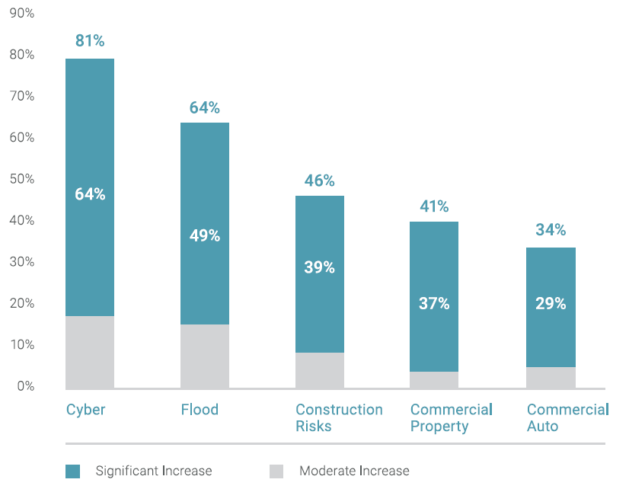
Commercial Lines with Largest
Demand Increase: 2017:Q3
Percentage Indicating Increase
Peak = 2001:Q4 +28.5%
Cyber is seeing the largest increases in demand
Source: Council of Insurance Agents and Brokers; USC Center for Risk and Uncertainty Management.
Note: CIAB data cited here are based on a survey. Rate changes earned by individual insurers can and do vary, potentially substantially.

Slide 28
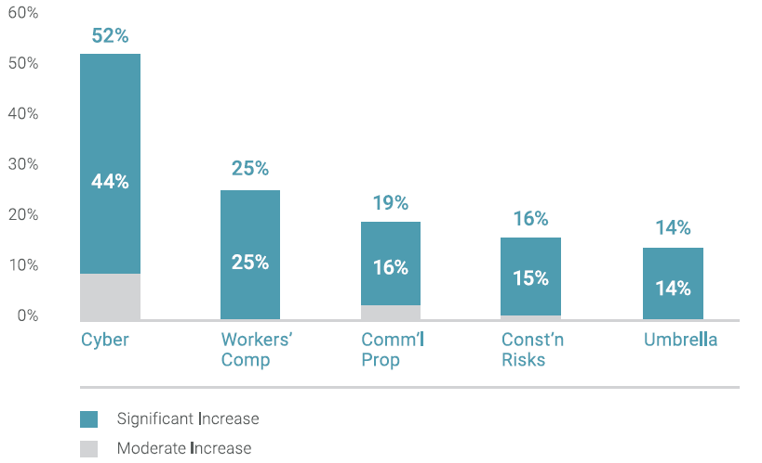
Commercial Lines with Largest
Capacity Increase: 2017:Q3
Cyber is seeing the largest capacity increases in demand
Source: Council of Insurance Agents and Brokers; USC Center for Risk and Uncertainty Management.
Note: CIAB data cited here are based on a survey. Rate changes earned by individual insurers can and do vary, potentially substantially.

Slide 29
Cyber Liability Coverage for Public Power Utilities
Typical cyber policies include:
  Security & Privacy Liability
  Multimedia & Intellectual Property Liability
  Network Interruption & Recovery
  Privacy Regulatory Defense & Penalties
  Network Extortion
  Reputational Damage
  PCI Fines
Unique coverage for Public Power Utilities:
  Broad definition of computer network to include all SCADA systems and system control rooms
  Coverage for NERC/FERC fines and penalties

Slide 30
D&O Pressure: Number of Federal Securities Class Actions, 2013 – 2017*
Number of Class Actions
The number of securities class actions is rising sharply, putting pressure on D&O coverage
*As of Nov. 16, 2017.
Source: Stanford University Law School: http://securities.stanford.edu/

Slide 31
Workers Compensation Combined Ratio: 1994–2016P
WC results have improved markedly since 2011
Workers Comp Is an Example of a Line that Was Recently Restored to Health Through the Return of Rate Adequacy
Sources: A.M. Best (1994-2009); NCCI (2010-2016P) and are for private carriers only..

Slide 32
McNeary Consulting Services

Slide 33
Consulting Services
Ongoing Services
Policy Review
Loss Control Services
Risk Management Review
Mergers & Acquisitions/Due Diligence
Broker Selection Process
Self-Insurance Consulting Services
Competitive Bidding Process

Slide 34
Policy Review
The objectives:
Complete, objective review of existing insurance coverages
Ensure that all insurance policies are adequate and up-to-date
Ensure optimal cost efficiency and eliminate coverage gaps
Our approach:
Collection of corporate policies
Industry benchmarking
Review of financials
Preparation of written evaluation
Complete policy analysis
Meet with client to review recommendations
Client Benefits:
Elimination of coverage gaps, duplications, and inefficiencies
Peace of mind in knowing that coverages are up to industry standards
The optimal insurance policy portfolio at the best possible price
Recommendations and strategies to reduce cost of risk

Slide 35
Competitive Bidding Process
The objectives:
Optimal insurance products secured through a comprehensive bidding process
Match client insurance needs with optimal market solutions
Eliminate the time investment of the client in the selection process
Our Approach:
Consolidate current policy data
Identify brokers to participate
Assign markets by broker distribute specs
Handle broker questions
Analyze submitted bids
Establish optimal coverages/deductibles
Prepare specs package
Meet with client to make selection
Client Benefits:
Lower cost of insurance with optimum competition
Broader coverage without fatal flaws
Equitable and professional purchasing process

Slide 36
Broker Selection Process
The objectives:
Ensure you have optimal insurance coverage at the best possible pricing available in the marketplace
Partner you with the optimum broker relationship for your needs
Peace of mind from making a well-informed decision
Our Approach:
Identify qualified potential brokers
Prepare outline of current program
Prepare broker questionnaire
Send package to brokers
Schedule oral broker presentations
Review current exposures
Establish parameters
Client decision with McNeary input
Client Benefits:
An optimal “politically correct” selection decision free of bias or favoritism
Significant time and stress savings by outsourcing the evaluation process
Peace of mind in selecting the broker that best fits your needs
Sound methodology to convert broker compensation from commission to flat fee

Slide 37
TPA Review
The objectives:
Ensure that you have optimal claim handling at the best possible pricing available in the marketplace
Partner you with the best TPA relationship for your needs
Peace of mind from making a well-informed decision
Our Approach:
Identify qualified potential TPA’s
Prepare outline of current program & review selected claim files for best practices
Prepare TPA questionnaire
Send package to TPAs
Schedule oral presentations
Review historical claims date
Establish parameters
Client decision with McNeary input
Client Benefits:
An optimal “politically correct” selection decision free of bias or favoritism. Significant time and stress savings by outsourcing the evaluation process. Peace of mind in selecting the TPA that best fits your needs.

Slide 38
Ongoing Services
The objectives:
Identify exposures to loss
Examine feasibility of alternative risk management techniques
Select best approach
Implement selected program
Monitor Results
Our Approach:
Serve as client advocate & facilitator
Identify & evaluate exposures
Claim review & oversight, including loss projections
Check policies, endorsements, audits, etc.
Review engineering, recommend actions, negotiate time frames
Oversee/manage Renewal process
Assemble , analyze, evaluate premium & loss data
Review loss control/safety programs & make recommendations
Review contracts/hold harmless language
Prepare Insurance Reference Manual (IRM)
Client Benefits:
Unbiased expertise and advice on risk management issues
Reduction of cost of risk
Reduction in workload related costs
Peace of mind regarding coverages vs. exposures
Better service from brokers, carriers and other vendors
Elimination of coverage gaps, duplications and inefficiencies

Slide 39
Thank you!
McNeary Consulting Services
Lynne Skelton
direct: 704.367.7131
lynne_skelton@ajg.com
Barbara Valentine
direct: 704.367.7129
Barbara_valentine@ajg.com

